Slide 1



Artificial Intelligence Based Network Management
Ivan’s initial survey
16.08.18

Slide 2
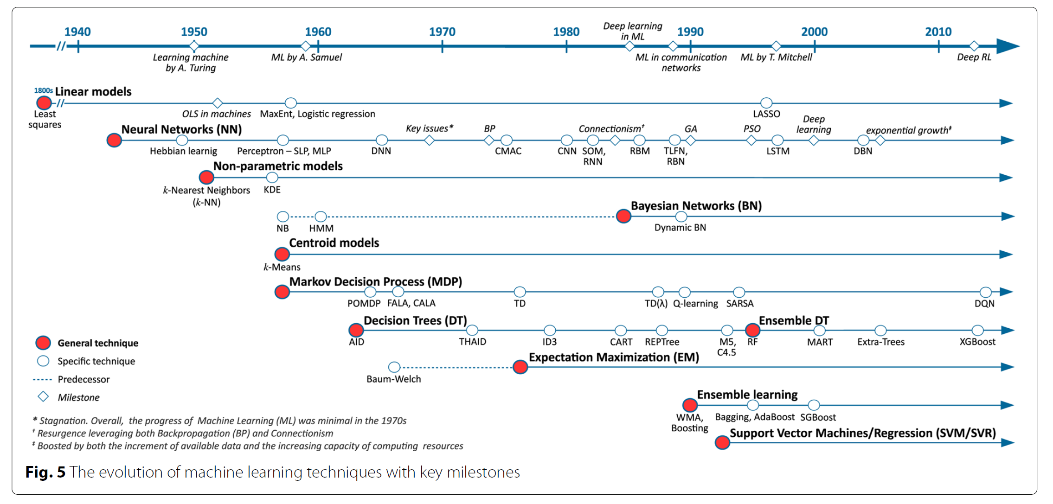
The evolution of AI
[1] R. Boutaba, M. A. Salahuddin, N. Limam, S. Ayoubi, N. Shahriar, F. Estrada-Solano, and O. M. Caicedo, “A comprehensive survey on machine learning for networking: evolution, applications and research opportunities,” Journal of Internet Services & Applications, vol. 9, no. 1,p. 16, 2018.

Slide 3
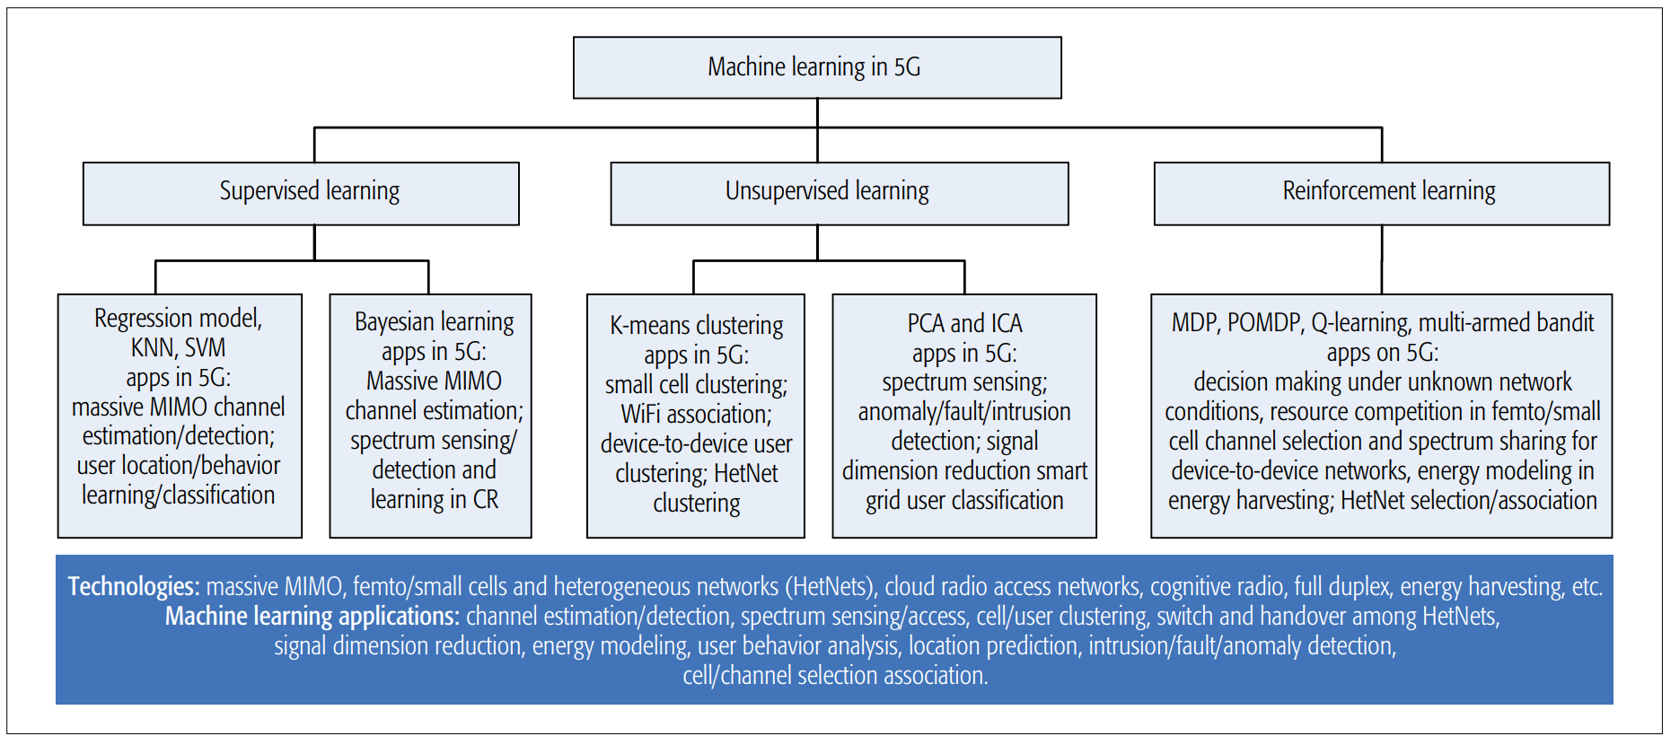
Classification form the perspective of AI
[2] C. Jiang, H. Zhang, Y. Ren, Z. Han, K. C. Chen, and L. Hanzo, “Machine learning paradigms for next-generation wireless networks,” IEEE Wireless Communications, vol. 24, no. 2, pp. 98–105, 2017.

Slide 4
Classification form the perspective of NM
NM
configuration
accounting
performance
Fault
security
[3] I.-T. R. M.3400, “Tmn management functions,” 1992.
[4] G. P. Kumar and P. Venkataram, “Artificial intelligence approaches to network management: recent advances and a survey,” Computer Communications, vol. 20, no. 15, pp. 1313–1322, 1997.
[5] S. Ayoubi, N. Limam, M. A. Salahuddin, N. Shahriar, R. Boutaba, F. Estrada-Solano, and O. M. Caicedo, “Machine learning for cognitive network management,” IEEE Communications Magazine, vol. 56, no. 1, pp. 158–165, 2018.

Slide 5
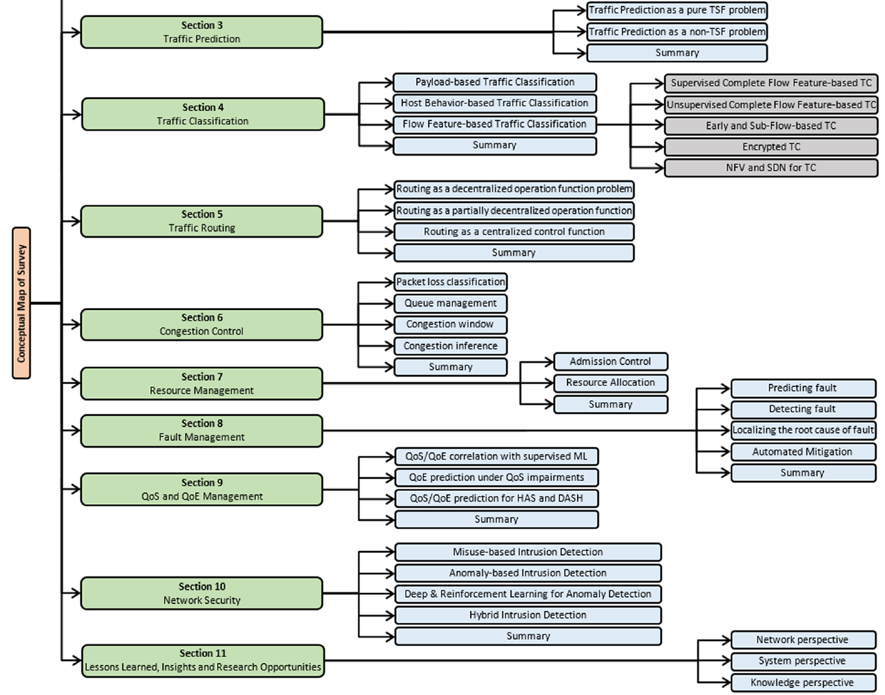
A comprehensive survey
[6] R. Boutaba, M. A. Salahuddin, N. Limam, S. Ayoubi, N. Shahriar, F. Estrada-Solano, and O. M. Caicedo, “A comprehensive survey on machine learning for networking: evolution, applications and research opportunities,” Journal of Internet Services & Applications, vol. 9, no. 1, p. 16, 2018.

Slide 6

A Case of AI-based NM: Deep Q Learning
AI
SM
RL
UM
Sarsa
DQL
Q-Learning
Policy Gradients
Actor Critic
Monte Carlo
…

Slide 7













----Reinforcement Learning
$$Agent$$
$$Envirement$$
$$L\left(ω\right)$$
$$R_{t+1}$$
$$R_{t+1}$$
Knowledge
Model
$$S_{t}$$
New-DQN
$$ε−$$
greedy
$$Policy$$
$$Q(S_{t},A_{t})$$
$$a_{best}$$
$$a_{best}$$
Real World
Old-DQN
$$Q(S_{t+1},A_{t+1})$$
$$S_{t+1}$$
States
Actions
Rewards

Slide 8

----Q Learning
$$Agent$$
$$Envirement$$
$$L\left(ω\right)$$
$$R_{t+1}$$
$$R_{t+1}$$
Knowledge
Model
$$S_{t}$$
New-DQN
$$ε−$$
greedy
$$Policy$$
Q-Table
$$Q(S_{t},A_{t})$$
$$a_{best}$$
$$a_{best}$$
Real World
Old-DQN
$$Q(S_{t+1},A_{t+1})$$
$$S_{t+1}$$
Q-Table
Q-Function
$ε−$greedy

Slide 9



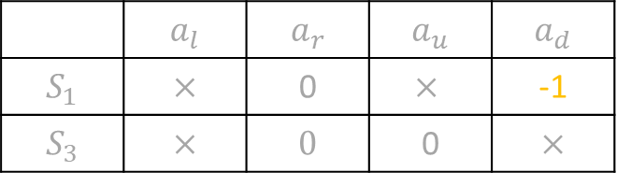
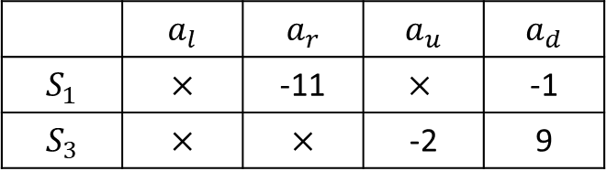
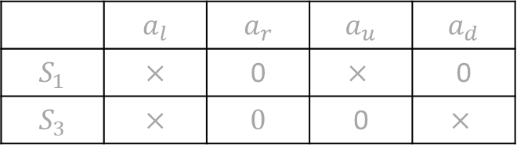
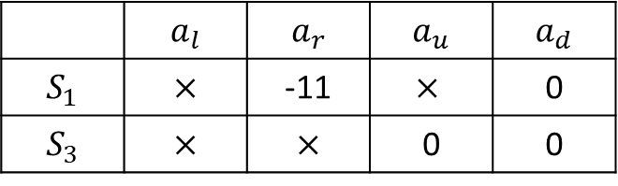



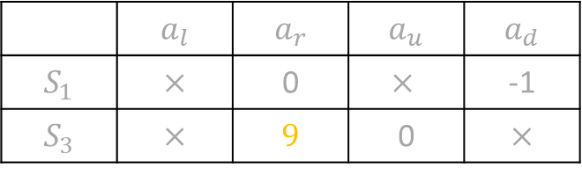
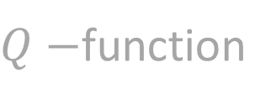
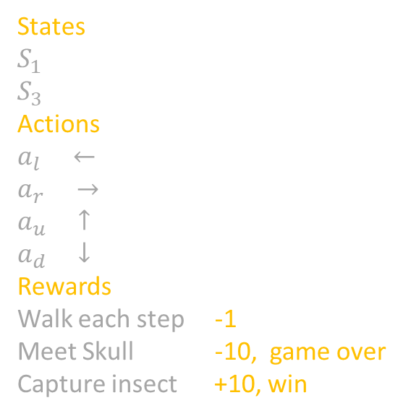






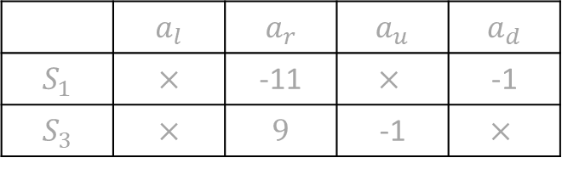



----Q Learning
$Q−$function
Initial Q-table
 | $$a_{l}$$ | $$a_{r}$$ | $$a_{u}$$ | $$a_{d}$$
$$S_{1}$$ | $$×$$ | 0 | $$×$$ | 0
$$S_{3}$$ | $$×$$ | $$0$$ | 0 | $$×$$
1
2
$$ε−greedy$$
$ε$probability randomly chooses action
3
4
$$Step 1$$
$$Step 2$$
$$Q\left(s_{1},a_{d}\right)=−1+$$
$$Q\left(s_{3},a\right)$$
$$Q\left(s_{3},a_{u}\right)=−1+$$
$$Q\left(s_{1},a\right)$$
States
$$S_{1}$$
$$S_{3}$$
Actions
$$a_{l} ←$$
$$a_{r} →$$
$a_{u} ↑$
$$a_{d} ↓$$
Rewards
Walk each step -1
Meet Skull -10, game over
Capture insect +10, win
 | $$a_{l}$$ | $$a_{r}$$ | $$a_{u}$$ | $$a_{d}$$
$$S_{1}$$ | $$×$$ | 0 | $$×$$ | -1
$$S_{3}$$ | $$×$$ | $$0$$ | 0 | $$×$$
 | $$a_{l}$$ | $$a_{r}$$ | $$a_{u}$$ | $$a_{d}$$
$$S_{1}$$ | $$×$$ | 0 | $$×$$ | -1
$$S_{3}$$ | $$×$$ | $$9$$ | 0 | $$×$$
$$Step 3, 4…i$$
F$i$nal Q-table
 | $$a_{l}$$ | $$a_{r}$$ | $$a_{u}$$ | $$a_{d}$$
$$S_{1}$$ | $$×$$ | -11 | $$×$$ | -1
$$S_{3}$$ | $$×$$ | $$9$$ | -1 | $$×$$
$$Q\left(s_{1},a_{r}\right)=−10−1$$
$$Q\left(s_{3},a_{d}\right)=−1+10$$
 | $$a_{l}$$ | $$a_{r}$$ | $$a_{u}$$ | $$a_{d}$$
$$S_{1}$$ | $$×$$ | -11 | $$×$$ | 0
$$S_{3}$$ | $$×$$ | $$×$$ | 0 | 0
 | $$a_{l}$$ | $$a_{r}$$ | $$a_{u}$$ | $$a_{d}$$
$$S_{1}$$ | $$×$$ | -11 | $$×$$ | -1
$$S_{3}$$ | $$×$$ | $$×$$ | -2 | 9

Slide 11

----Deep Q Learning
$$Agent$$
$$Envirement$$
$$L\left(ω\right)$$
$$R_{t+1}$$
$$R_{t+1}$$
Knowledge
Model
$$S_{t}$$
New-DQN
$$ε−$$
greedy
$$Policy$$
Q-Table
$$Q(S_{t},A_{t})$$
$$a_{best}$$
$$a_{best}$$
Real World
Old-DQN
$$Q(S_{t+1},A_{t+1})$$
$$S_{t+1}$$

Slide 12
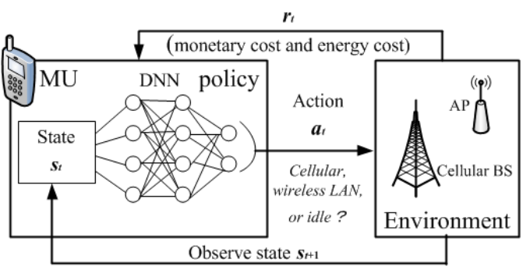
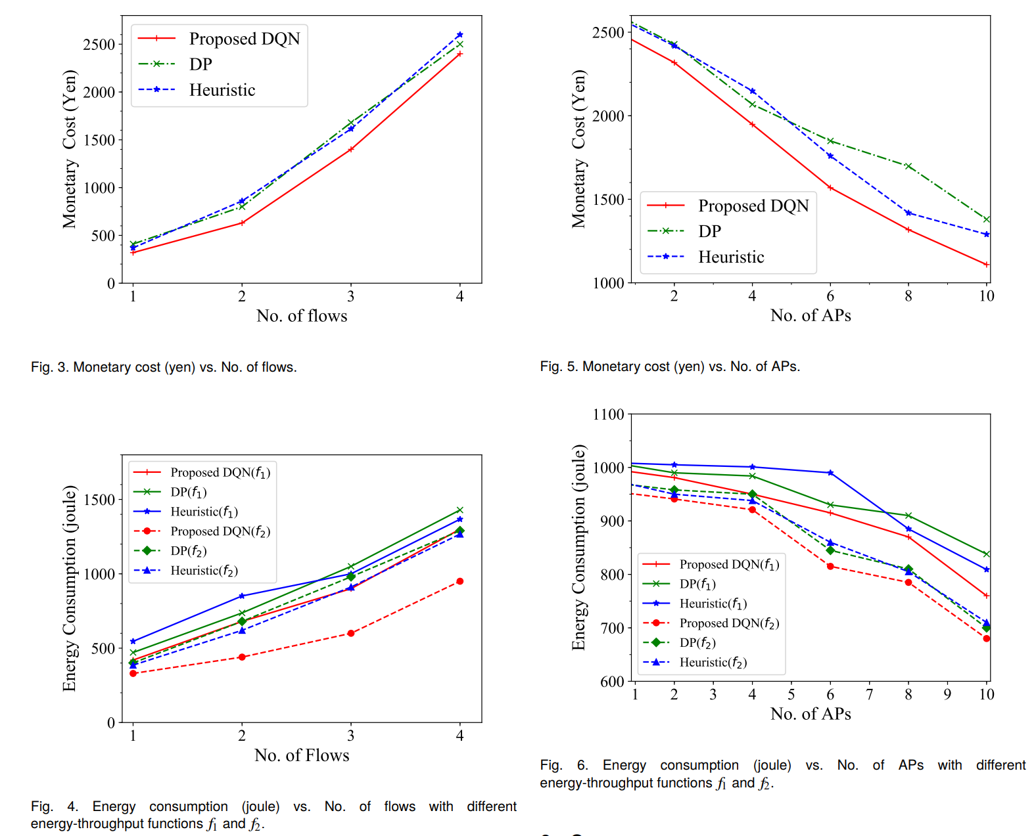
----The case of DQL-based NM
States
The location and remaining file size
Actions
Choose a download method form wireless LAN,
cellular network or Idle
Rewards
The sum of monetary cost and energy cost
[7] Zhang C, Liu Z, Gu B, et al. A Deep Reinforcement Learning Based Approach for Cost- and Energy-Aware Multi-Flow Mobile Data Offloading[J]. Ieice Transactions on Communications, 2018.

Slide 13
My next stop
Find the possible case of
AI-based industrial automation network

Slide 14

Thank you
AI-based NM
Ivan
14.08.18

